Slide 1
Morphological aspects of the crystals
Faculty of physics
Semnan university
Presenter: Majid jafar tafreshi
Spring 2021

Slide 2
What is the crystal?
A historical review:
most of us call up images of regular, symmetric forms, perhaps the prismatic form of rock-crystal, or the dendritic form of snow crystals.
We use the term “crystal clear” to imply something transparent and pure.
The ancient Greeks used the term crystal (κρνσταλλο) to imply clear, transparent, and hard ice; rock-crystal

Slide 3
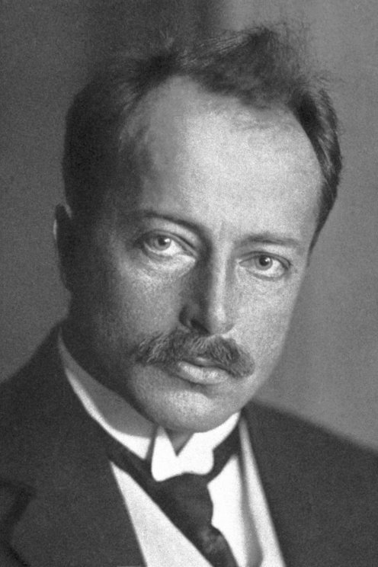
What is the crystal?
A historical review:
In 1912, Von Laue demonstrated using X-rays that a crystal is constructed of unit
cells, and that it is possible to determine atomic positions by means of diffraction
phenomena.

Slide 4
The birth of the concept of crystal growth, seventeenth century
In the seventeenth century, the Danish anatomist Nicolaus Steno (1638–1687) collected many samples of rock-crystals, and he measured the interfacial angles of hexagonal prisms.
His finding was “law of the constancy of interfacial angles.”

Slide 5
Nicolaus Steno put forward two important concepts:
He argued that rock-crystals were not of organic origin formed by the activity of bacteria in the soil, as was widely believed, but that they grew through the agglutination of tiny particles formed through inorganic processes taking place in high-temperature aqueous solution.
He explained that the reason why rock-crystals show hexagonal prismatic forms bounded by six triangular faces at the tip and six rectangular faces, and sometimes show tapering prismatic or platy forms, is that the growth rates are different depending on crystallographic direction, i.e. on the different crystal faces.

Slide 7
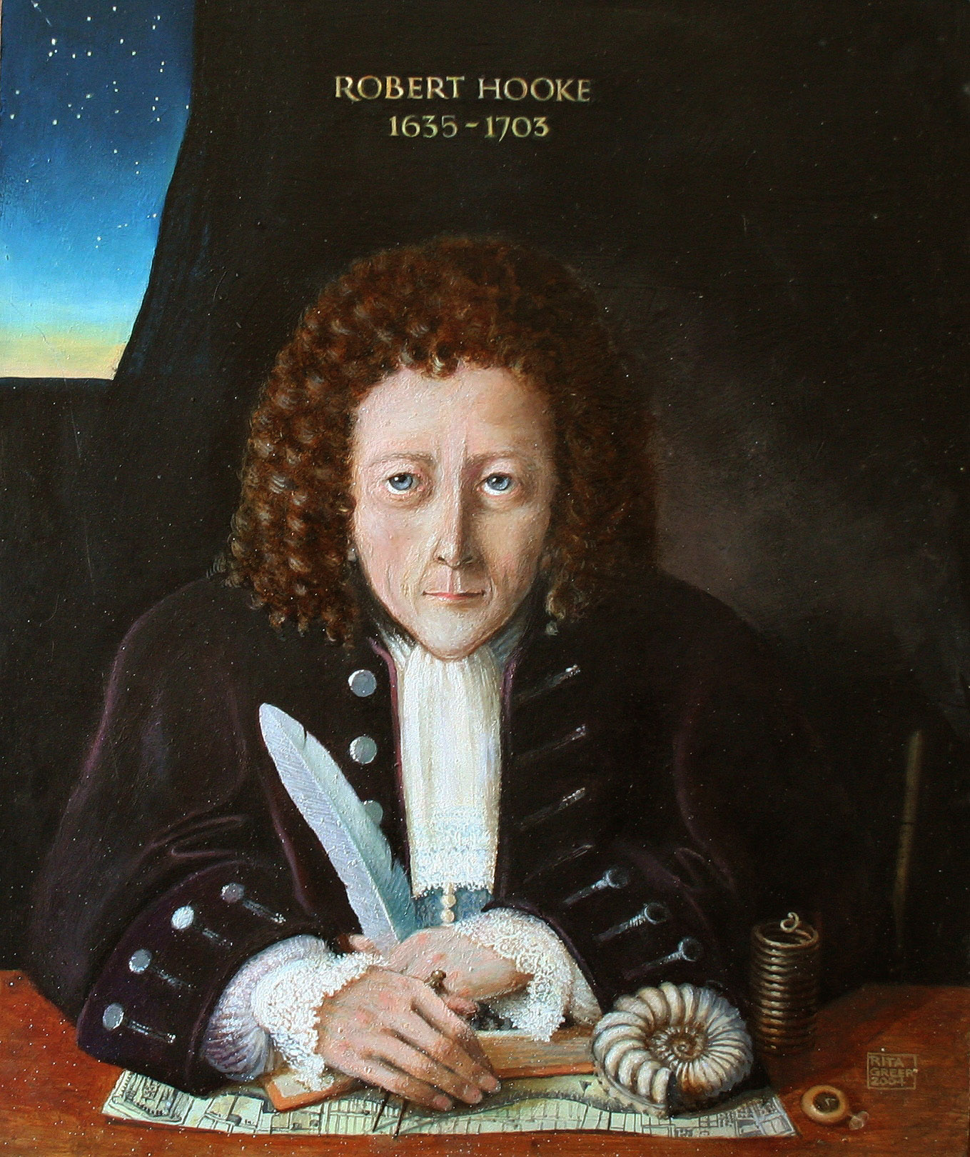
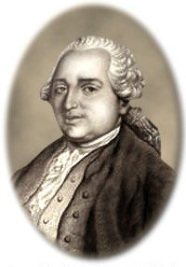
The birth of the concept of crystal growth, eighteenth century
In eighteenth century Robert Hooke and Villiers de l’Isle-Adam noted for alum (Potassium aluminum sulfate) and NaCl crytals different forms when they are grown in different conditions respectively.
Rome de l’Isle
Robert Hooke

Slide 8
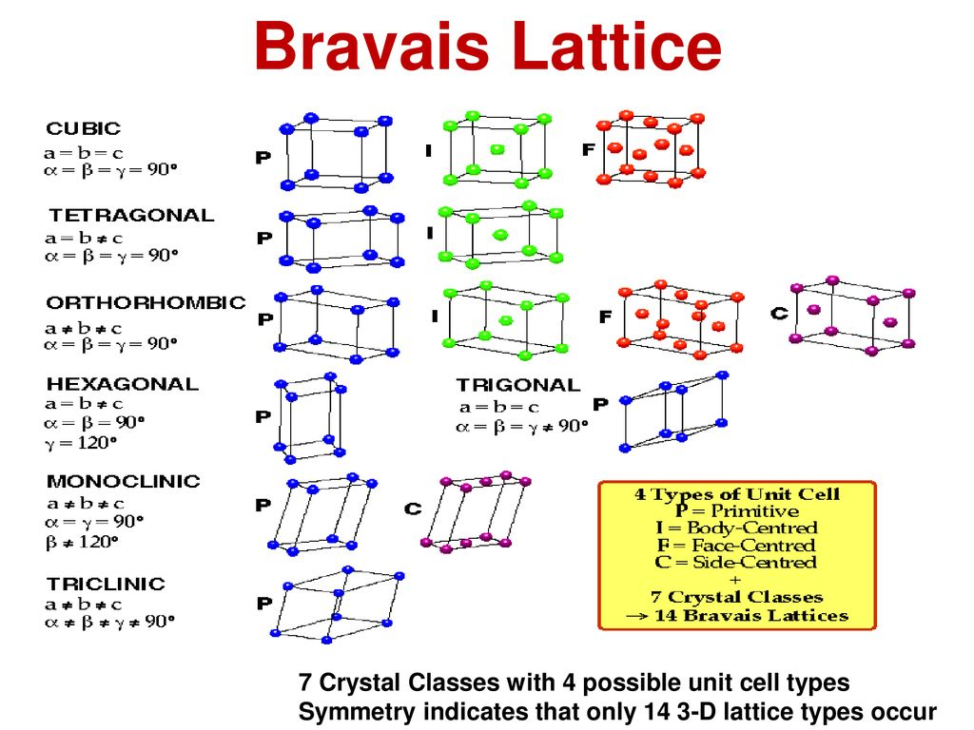
The birth of the concept of crystal growth, nineteenth century
crystal morphology was systematized to fourteen types of unit cells, seven crystal systems and thirty-two crystal groups.

Slide 9
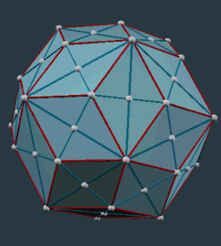
The birth of the concept of crystal growth, nineteenth century
From the mentioned structures, two following macroscopic treatments on the morphology of crystals emerged.
The Bravais empirical rule, which states that there is a close correlation between the polyhedral forms of a crystal and the lattice type.
Theoretical treatments by Gibbs, Curie, and Wulff on equilibrium form showed that the equilibrium form of a crystal having anisotropy should be polyhedral, not spherical, as would be expected for the equilibrium form of an isotropic liquid droplet.

Slide 10
It became necessary to understand how crystals form a wide variety morphologies forms as:
Polyhedral
Denderitic
spherulitic
Achieved through theories such as:
Layer growth theory 1930 Volmer, Kossel, Stranski.
Spiral growth theory 1949 Frank.
Theory of morphological instability 1963, Mullins and Sekera.

Slide 11
In twentieth century
The understanding of the mechanism of the crystal growth progressed experientially.
Advances in optical microscopy and electron microscopy made it possible to observe and measure microstructures of the nanometer order.

Slide 12
Morphology, perfection, and homogeneity
These properties of a crystal are directly related to how the crystal grows.
Our understanding of the factors determining these parameters provides us information necessary for development of industries.
Since the growth mechanism of crystals have become understood at the atomic level, it has become clear how the:
Micromorphology (morphology of growth spirals and etch pits)
Macromorphology (polyhedral, skeletal and dendritic forms)
of crystals are determined

Slide 13
Complicated and complex systems
Knowledge of:
the growth mechanism
Morphology
Perfection
Homogeneity of single crystals
Creates a base from which we may understand:
the morphology exhibited by polycrystalline aggregates.
the mechanism of formation of textures and structures.

Slide 14
Single and polycrystals
Single crystal:
When there is no distortion in the structure or no change in orientation throughout a crystal.
polycrystalline aggregate:
A solid consisting of many single crystals with different orientations (metals, rocks and ceramics).
Real crystals (nearly perfect single crystals):
A crystal containing various defects and lattice order.

Slide 15
Morphology of crystals
The morphology of single crystals is determined by:
Crystal structure (the internal factors)
Crystal growth conditions
Process of growth (the external factors).
ex. Snow crystals:
Polyhedral forms of the hexagonal prism and hexagonal plates Familiar dendritic form with branches in six directions

Slide 16
Crystal forms
The origin of the variations in morphology exhibited by the same single crystal.
Ex. A single crystal might exhibit:
Polyhedral form bounded by flat crystallography
A hopper or skeletal form bounded by faces with step-wise depressed center at a face
Dendritic form

Slide 17
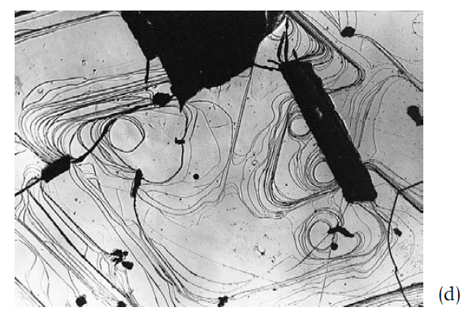
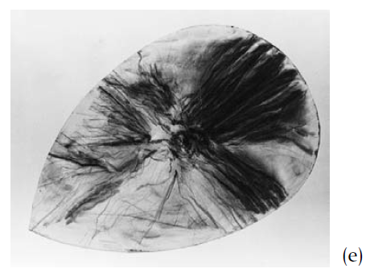
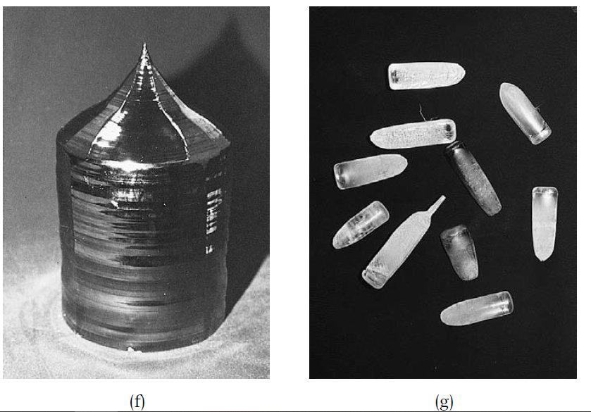
Various forms exhibited by crystals

Slide 18
origin of the variations
Step patterns
Fluctuation in growth rate
Growth under small driving force
Using seed crystal
Twining and epitaxial growth

Slide 19
Tracht and habitus
Polyhedral crystals bounded by flat crystal faces usually take characteristic forms controlled by the symmetry elements of the crystal (point) group to which the crystal belongs and the form and size of the unit cell.

Slide 20
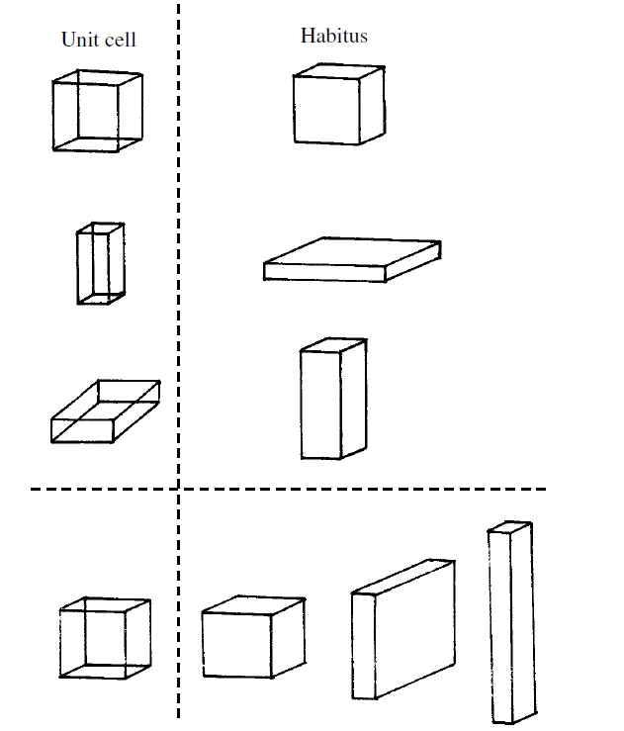
Tracht and habitus
a=b=c or a≈b≈c isometric form such as Tetrahedron, Cube, Octahedron and dodecahedron
a≈b<c platy form
a≈b>c prismatic form

Slide 21
Example
NaCl:
Grown in aqueous solution gives cubic habit.
Adding Pb or Mn ions impurities gives Octahedral habit.
Aqueous solution in wineskin in dry shade, numerous needle of NaCl crystals.

Slide 22
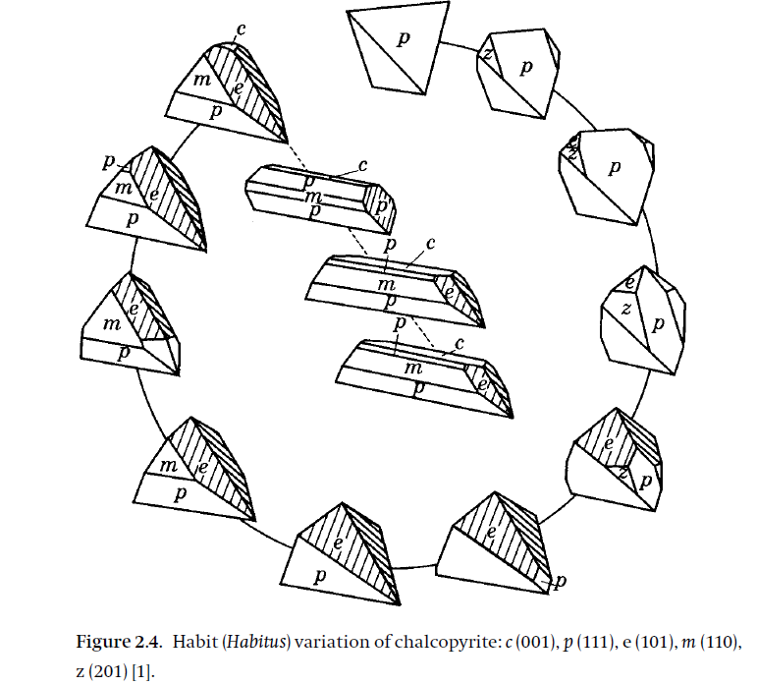
Unusual Habitus of chalcopyrite (CuFeS₂)

Slide 23
What is Tracht?
Tracht, is applied to describe the variation of forms due to the combination and degree of development of faces within the same category of Habits.
In English There is no distinction between Habits and Tracht, but in German it is not the case.

Slide 24
Crystal growth
Crystal growth is the process of the birth and development of a solid phase with a regular structure out of a disordered and irregular state. It can be regarded as a first-order phase transition.
Equilibrium thermodynamics versus kinetic thermodynamics: The science dealing with the phase transition is thermodynamics.
Driving force: The degree of departure from the equilibrium state corresponds to the driving force for growth or dissolution to take place. This relates to the difference between the dotted line and the solubility curve indicated by the solid line on the phase diagram
Heat and mass transfer
Nucleation
Interfaces

Slide 25
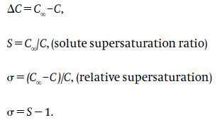
Driving force
Growth from vapor phase
Growth from solution phase
Growth from melt phase

Slide 26
Nucleation
Three processes of crystal growth:
A driving force is applied, which causes the process to proceed by the formation of a supersaturated or supercooled state.
Particles smaller than a critical size, which may be referred to as clusters, are formed in the system. Some of these clusters, out of the many that repeatedly come together and part again, may by chance grow larger than the critical size. The process that describes the situation up to the point where the particles reach critical size may be called the nucleation stage.
Once it exceeds the critical size, the particle can grow larger.

Slide 27
Nucleation

Slide 28
Interfaces
After nucleation solute components will be incorporated into the crystal at the expense of much smaller energy than that necessary for nucleation.
Depending on whether interface atomically consists of rough or smooth, growth mechanism will be different.
The rough interface consist entirely of kinks.
The smooth interface comprises a flat surface, a small number of steps and a site where step is bent i.e. a kink.

Slide 29
Interfaces
Kossel and Stranski, where the first who focused their attention on the interface structure after considering the results obtained by Volmer Who demonstrated the existence of surface diffusion.

Slide 30
Schematic to show the layer-by-layer growth model due to two dimensional nucleation. This figure assumes the mode of nucleation to be the mononuclear model. Other models, such as the poly-nuclear or birth and spread models.

Slide 31
References
N. Steno, De Solido Intra Solidum Naturaliter Contento Dissertationis Prodromus, Florence,1669, trans. J. G. Winter, The Prodromus of Nicolous Steno’s Dissertation Concerning a Solid Body Enclosed by Process of Nature Within a Solid, New York, Hafner, 1968
Sunagawa, On the so-called triangular chalcopyrite, Bull. Geol. Surv., Japan 2, 1951, 253–67
I. Sunagawa, Variation in crystal habit of pyrite, Rep. Geol. Surv., Japan, no. 175, 1957, 41
W. Kossel, Zur Theorie der Kristallwachstums, Nachur. Ges. Gottingen, 2, 1927, 135–45
I. N. Stranski, Zur Theorie der Kristallwachstums, Z. Phys. Chem., 136, 1928, 259–78
M. Volmer, Zum Problem des Kristallwachstums, Z. Phys. Chem., 102, 1922, 267–75

Slide 32
Thank you for your attention

